Slide 1

Site to site VPN between Company Branches
Presented by:
Hoor Ahmed
Maram Ahmed
Yomna Adel
Nourhan Abd Elmawla
Under supervision of:
Eng. Khaled Abd Rabo
DEPI |2024

Slide 2

Project Overview
Objective:
Design a secure, scalable, and segmented network to support 30 employees.
Provide secure access to critical resources (servers, printers, internet), and isolate guest traffic.
Enable secure remote access for employees, with protection from cyber threats.

Slide 3
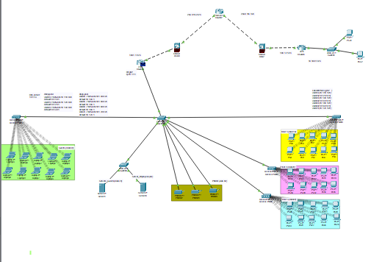
Network Topology Design
Router: Centralized routing for internal/external traffic.
Switches: Connecting workstations, printers, and servers.
Firewall: Enforcing security policies and managing inbound/outbound traffic.
Access Points (Wi-Fi): Segmented guest and employee Wi-Fi.

Slide 4
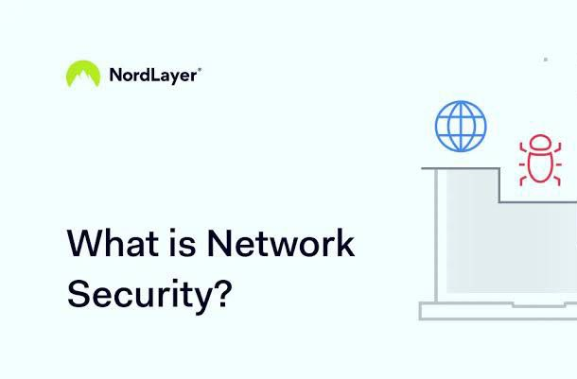
Security Measures Overview

Slide 5
Security Measures Overview
Network security
•Network security is the security provided to a network from unauthorized access and risks.
•It is the duty of network administrators to adopt preventive measures to protect their networks from potential security threats.
•Computer networks that are involved in regular transactions and communication within the government, individuals, or business require security.
•The most common and simple way of protecting a network resource is by assigning it a unique name and a corresponding password.

Slide 6
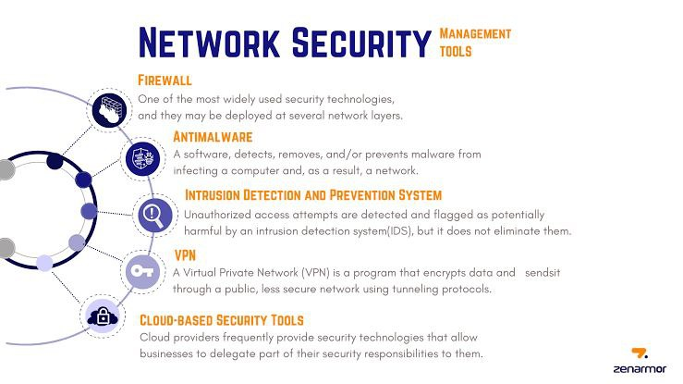

Slide 7
Vlans
VLANs enhance security by segmenting a network into isolated subnets, limiting access to sensitive data and reducing the risk of unauthorized access. They also contain broadcast traffic, preventing network-wide attacks from spreading across different VLANs.
In our topology , we created 3 different vlans (vlan 10 , vlan 20 , vlan 30) for employees (internal network) that has access to the employee server (vlan 60) and the printer (vlan 50) and can communicate with each other.
We also created a guest server (vlan 70) that can be accessed by guests (vlan 40) , they don’t have access to internal network for security wise.

Slide 8
Inter-Vlan routing
Inter-VLAN routing is needed to enable communication between devices on different VLANs. Since VLANs are isolated by default, routers or Layer 3 switches are required to route traffic between them, allowing resource sharing across the network while maintaining segmentation.
In our topology , we did router on stick:
It involves a single router interface, which is divided into subinterfaces for each VLAN ,Each subinterface is assigned an IP address, acting as the default gateway for its VLAN ,Trunk links are used between the router and the switch to carry traffic for multiple VLANs.

Slide 9
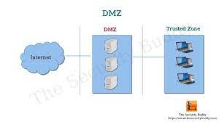
Access Control Lists (ACLs)
An Access Control List (ACL) is a set of rules used to filter network traffic and control access to network resources. It defines which packets are allowed or denied based on criteria like IP address, protocol, or port number. ACLs enhance security by restricting unauthorized access, preventing malicious traffic, and allowing only permitted communications within a network.
VLAN Access Restrictions: Guest VLAN restricted to internal network only; Employee VLAN can access resources on Server VLAN.

Slide 10
Site to Site VPN
A Site-to-Site VPN (Virtual Private Network) is a secure connection that allows two separate networks, typically from different geographic locations, to communicate securely over the internet. This is often done using firewalls or routers that support VPN capabilities, allowing organizations to extend their private networks across different physical sites.
Key Elements of a Site-to-Site VPN:
Encryption: The data transmitted between the two sites is encrypted
VPN Tunnel: A secure tunnel is established between two devices, such as firewalls, that acts as a direct link between the two networks.
Endpoints: Each site has a VPN device (usually a firewall or router) acting as an endpoint. These devices encrypt and decrypt traffic between the sites.
IKE (Internet Key Exchange): A protocol used to set up a secure, authenticated communication channel between two devices.
IPsec (Internet Protocol Security): Commonly used in site-to-site VPNs to provide secure transmission by authenticating and encrypting each packet sent over the VPN tunnel.

Slide 11
Steps of configuring site to site IPSEC VPN
Configure Site-to-Site IPsec VPN on ASA FWL:
• Create Crypto IKEv1 Policy: Establish IKE Phase 1, which defines the parameters for key exchange.
• Tunnel Group to Specify Pre-shared Key: Define the VPN peer and configure the pre-shared key.
• Create IPsec Transform Set: This is for IKE Phase 2, specifying encryption and authentication methods.
•ACL to Identify Traffic of Interest: Define access control lists (ACLs) to specify the traffic that will be encrypted and passed through the VPN.
• Create Crypto Map: This binds the IPsec policies to the peer and identifies traffic.
•Enable IKEv1 and Apply Crypto Map on Interface: Apply the crypto map to the ASA interface that will handle the VPN traffic.

Slide 12
Summary
The designed network provides robust security via segmentation, a strong firewall configuration, and secure remote access.
Regular monitoring and vulnerability assessments ensure that the network remains secure against evolving threats.

Slide 13


DEPI |2024
Thank You & Questions:

